Slide 1


Utah Division of Water Rights
Filing Applications
What You Need to Know
Amber Loveland—April 2021
June 21, 2004
Notes:
Start Card – This presentation will walk you through the process of obtaining a start card

Slide 2

Application Agenda
Discuss website tools for applications;
Readiness for filing a complete application;
Introduce the Public Land Survey system;
Discuss duty, diversion, and other use calculations, and;
Make an application map.
Questions

Slide 3
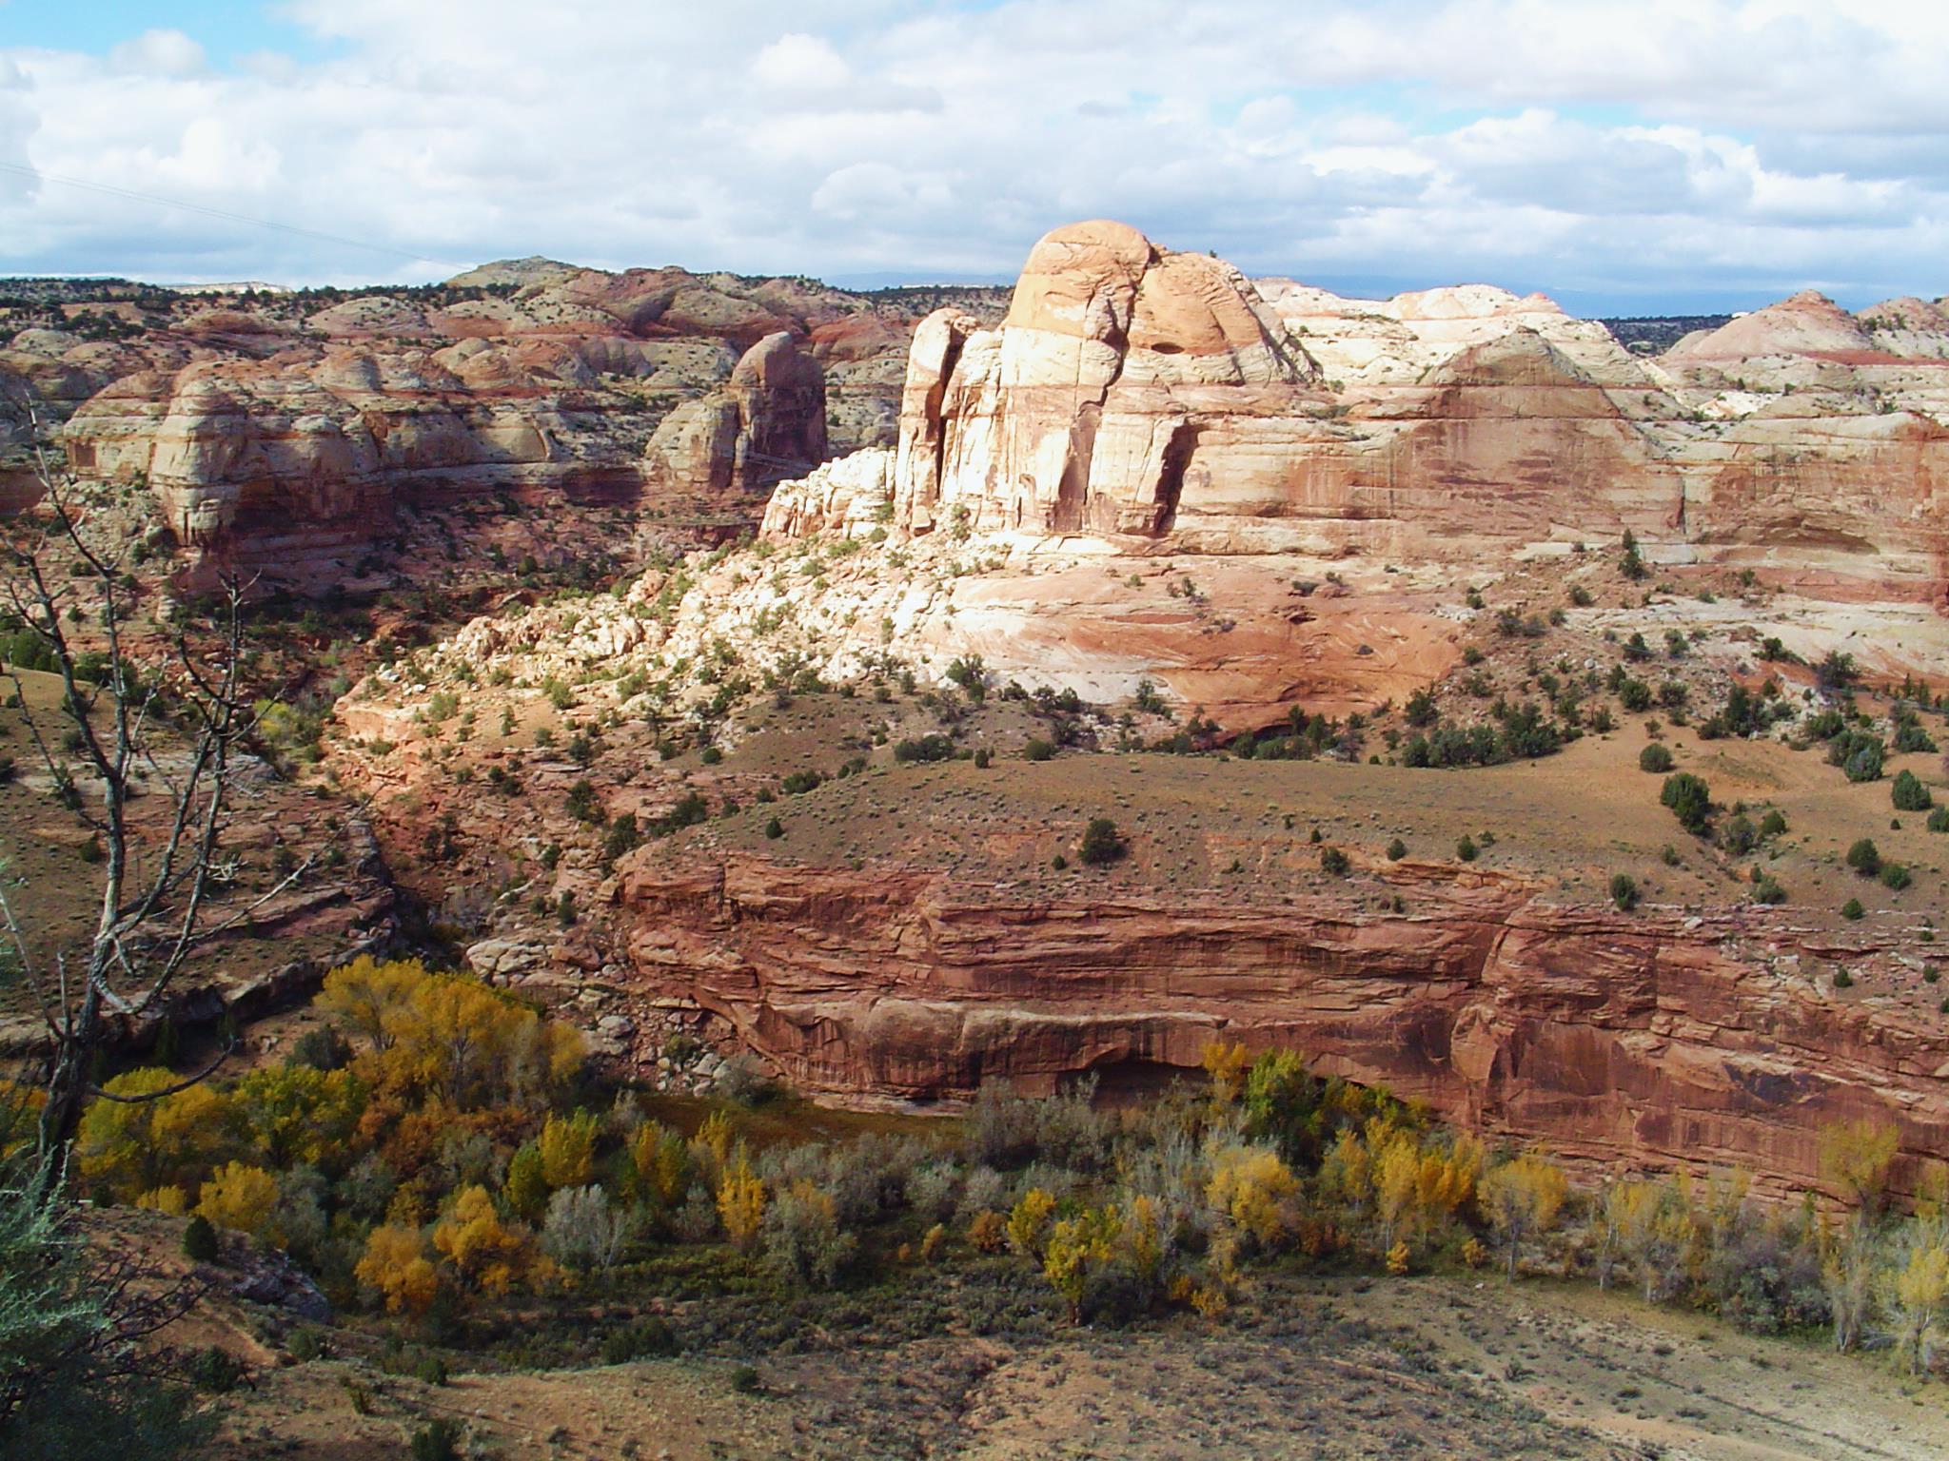
Website Tools for applications
Water Right

Slide 4
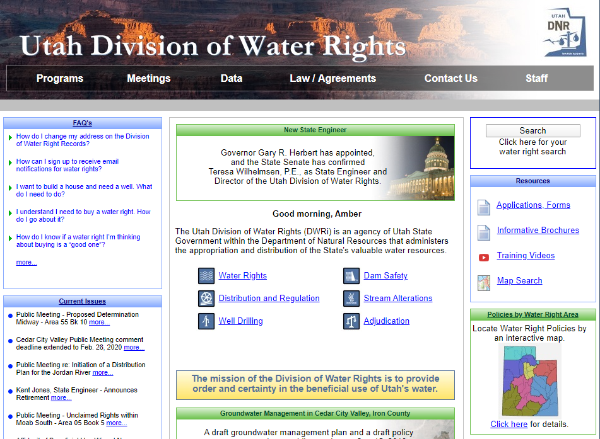
www.waterrights.utah.gov

Slide 5
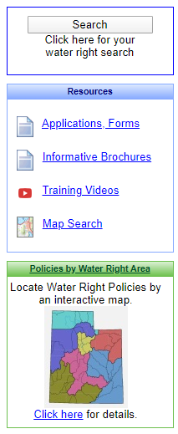
Helpful Database Tools
Search by water right number, application number, name, etc.
Find applications, update ownership, update address.
Find basic information for each water right area to review.
Notes:
Search tool: Can search by name, application number, search on a map, address, parcel, etc
*Discuss difference between water rights number and change number
*Sometimes a single change can include multiple water rights. If you are looking for the original change application or its correspondence, it will be placed on the lowest water right number.
Applications, forms: Find a link to all forms and wizards used here at division.
*Address change: the easiest way is to update online
Policy by Water Right: Click here for an interactive map

Slide 6
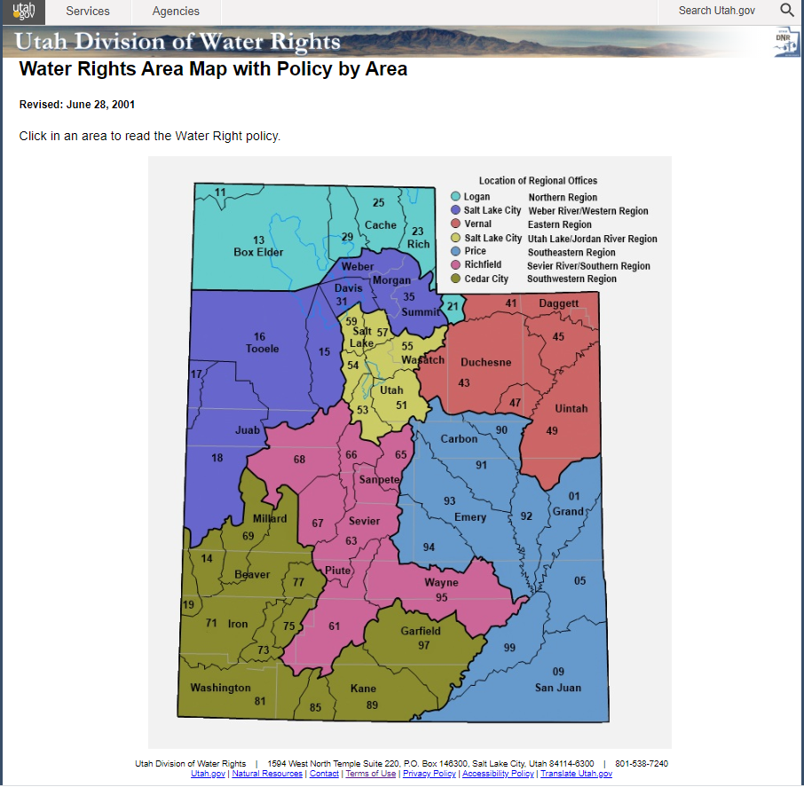
Notes:
Area Map
Can click to retrieve policy for each specific area, including specific information, decrees and ground management plans
Click on Rich County

Slide 7
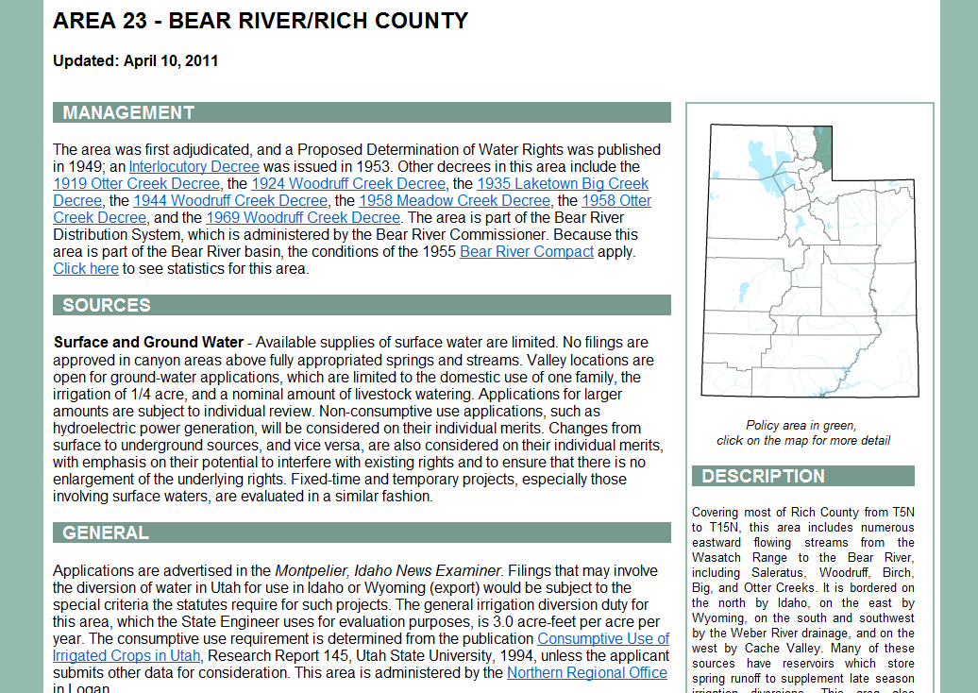
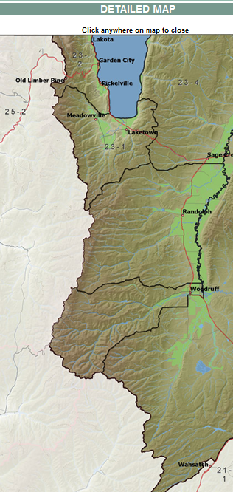
Surface and Ground Water :
…Valley locations are open for ground-water applications, which are limited to the domestic use of one family, the irrigation of .25 acre, and 10 livestock.
Notes:
Management Section
Decrees (adjudication process or from a court case)
Groundwater Management Plans (3 year study)
Sources Section
Find out if the area is open to new appropriates (application) or if it is closed and will need to file a change application
General Section
Discusses general information in area such as:
Where publishing will occur
Duty Value
Other permitting that may be needed
References, Scanned Docs, Modeling Sections
Provides links to technical publications for the area
**Overall, this will help you determine which area you are in, what type of application you can file, and what policies are in that area.

Slide 8
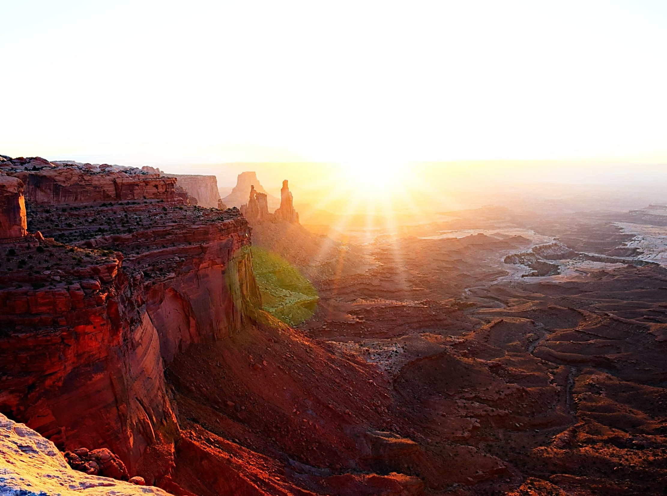
The Details of
Filing Applications

Slide 9
Elements Common to all Applications
The applicant’s name, address and ownership interest;
Flow (cfs), or volume (acre-feet) of water to be diverted;
Point of diversion (POD);
  Where the water will be diverted from the natural source (spring, stream, or underground well)
Beneficial use of the water;
Notes:
-Applicant Information: If there is more than one owner we need to know the owner’s interest on that water right.
-Water Source
-Amount of water
-Point of Diversion: Although your application is just a proposal, you will want to be as accurate as possible as to a avoid having to do an amendatory change during the proof process. Your POD will need to be within 150 feet of your proposal.
-Water Use: How are you going to use the water?

Slide 10
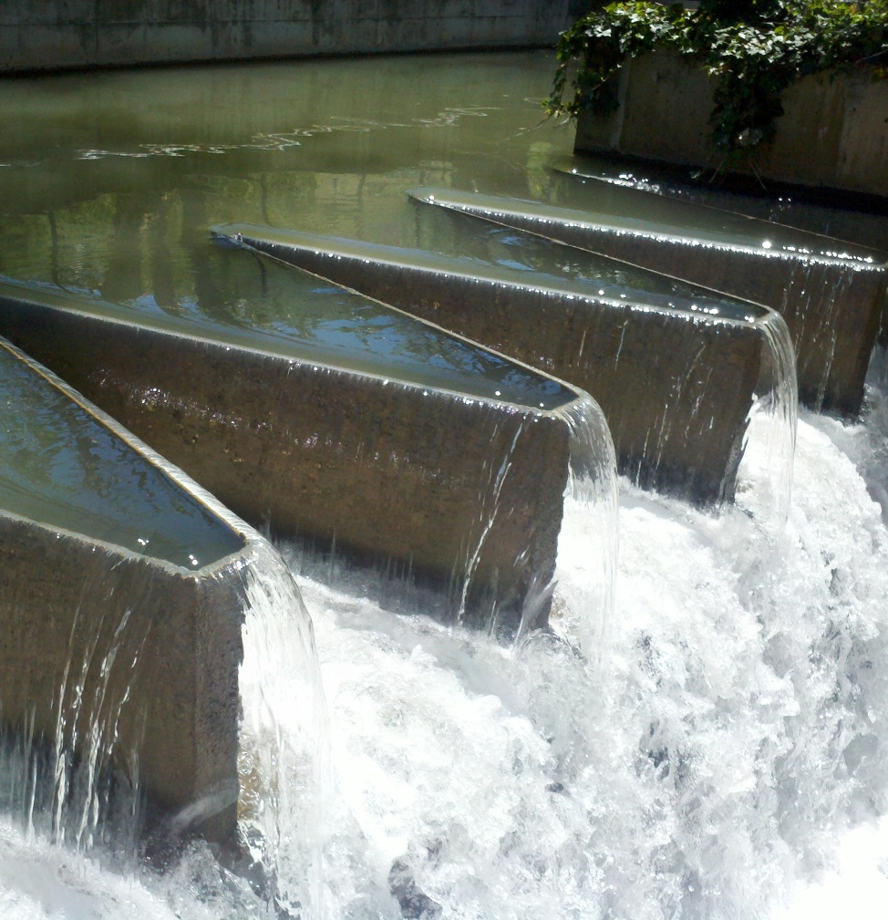
Place of use (POU);
  Location where the beneficial use will occur
Application map, to identify specific parcels on which the beneficial use will occur;
Signatures of all applicants/owners or legal agents;
Filing fee.
Notes:
-Place of Use
-Applications Map: Municipalities are exempt from filing a map
-Signatures
-Filing Fee: Begins at $150

Slide 11
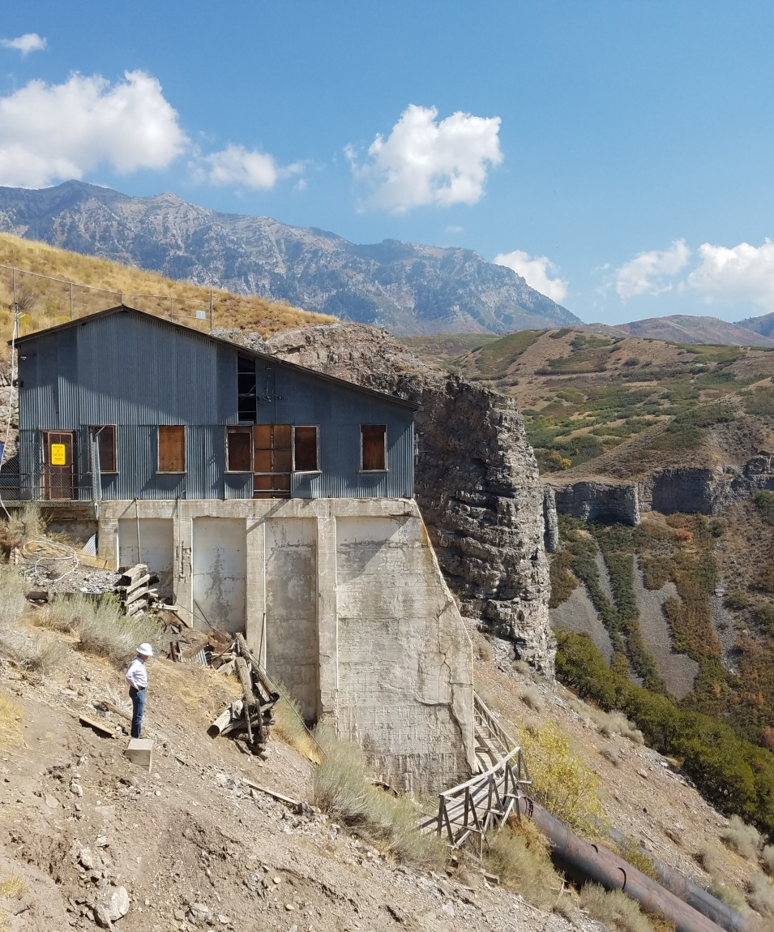
What You Need to Know
Basis of the water right
  New water right
  Existing water right
  Contract
  Shares in a company
Points of diversion
Places of use
Uses of the water
Notes:
Basis of the water right, what type of application are you going to file?
-New Water: Application to Appropriate
-Existing Water and want to change something other than ownership: change application. Either permanent or temporary (under 1 year)
-Contractual Water: Most often Weber Basin Water Conservancy District: Exchange
-Shares: Irrigation Company actually owns the water, so they will also be a party on the change app and will need to sign
“You want to file a change application. Great. What existing water right will you use? Where will you divert? Where will you use the water? How will you use the water?”

Slide 12
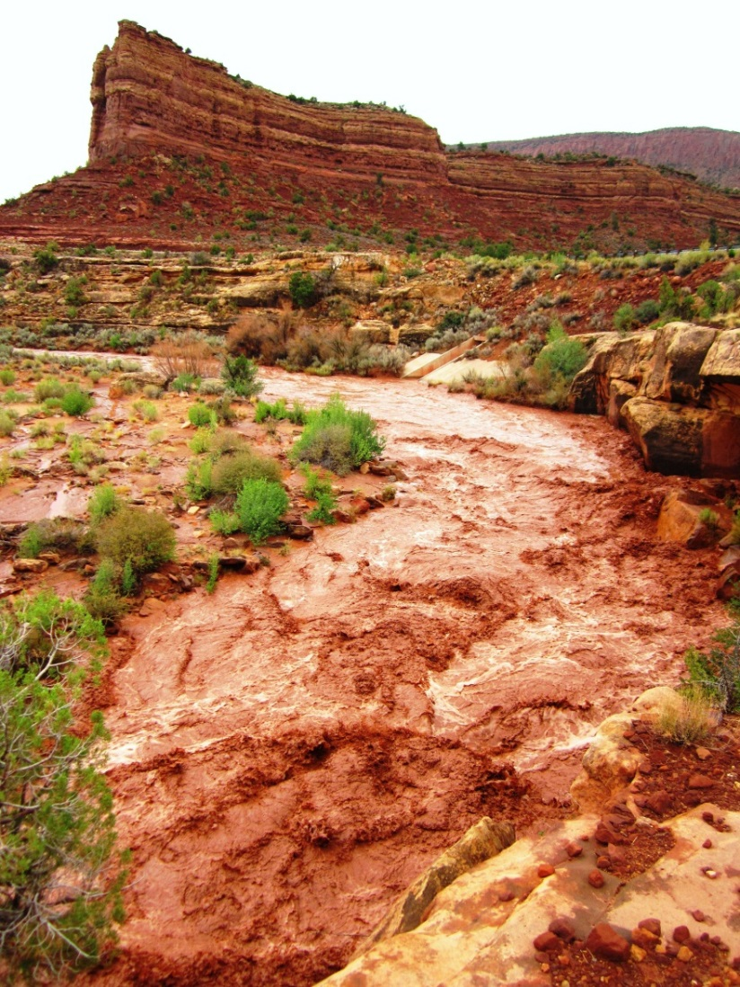
Common Filing Mistakes
Proper ownership
  Division’s records
  Share holder
  Contract owner
Need to complete a segregation
Proper evaluation of the water right
Notes:
-Proper Ownership: Whether on our records, as a shareholder, or a contract owner you will need to check to make sure your name is reflected. A Change cannot be filed unless you are the owner of record.
(If you buy a share from your neighbor be sure to go to the irrigation company to get a new share certificate released in your name. etc)
-Segregation Needed b/c
You have only want to file a change on a portion of your water right
You are one of several owners and want to change your portion
-Proper Evaluation: If you have a water use group where more than one water right is involved that is unevaluated, that will need to be addressed before moving forward with an application.

Slide 13


SEGREGATING WATER RIGHTS
73-3-27
  Split an existing water right into one or more separate water rights.
  Separate interest of an owner to file an application on their portion only.
  Divide up a water right to file proof on the developed portion only.
  Irrigation shares
  Just because
Notes:
1 Take a small portion out to change
2 Part of a project is complete (4 lot subdivision example)
3 Irrigation shares, aka “Share Statement”, taking a small portion of an irrigation company’s water and creating your own water right in order to file a change app.
4 Just because you want your own water right number

Slide 14
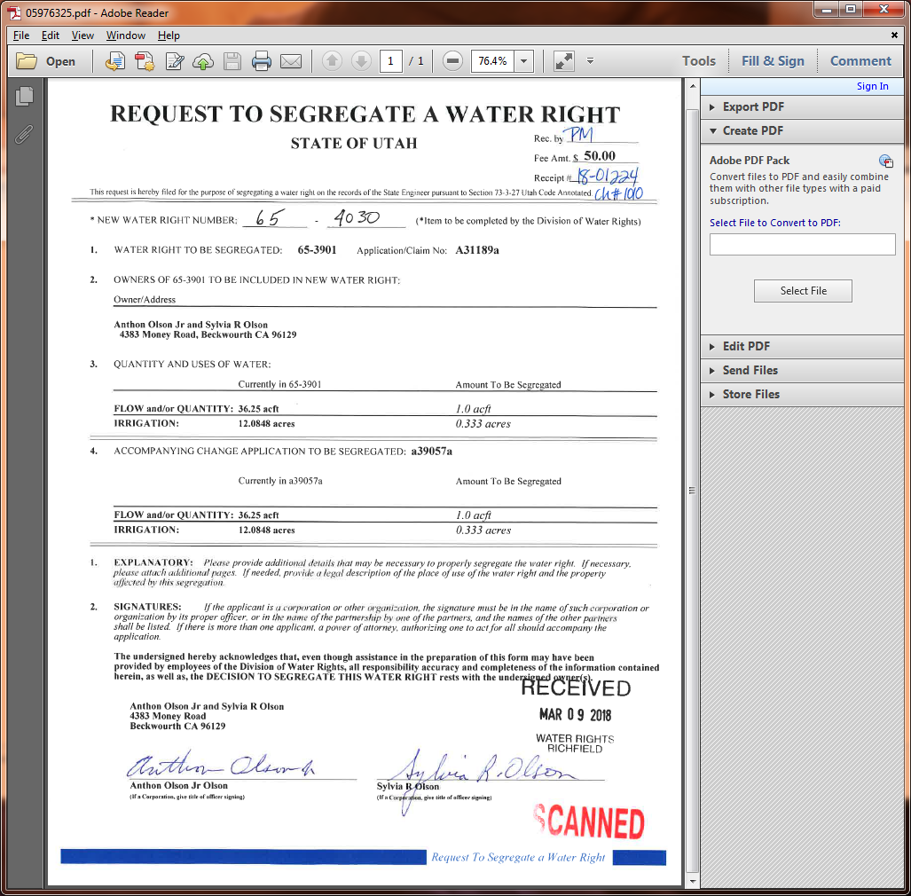
SEGREGATING WATER RIGHTS
New water right number after segregation
(Assigned by Division of Water Rights)
Original or parent water right number
Amount requested to be segregated
Acre-feet and uses in parent water right prior to segregation
Acre-feet and uses in change application prior to segregation
Amount requested to be segregated from change application
Owners requesting segregation and their signatures
Notes:
Start with WR # (parent right)
Amount of water/uses, if the water right is unevaluated it cannot be split our wizard should flag this issue
- Change applications will also need to be segregated
-Left side (parent side) will autofill from our website. The right side will be where you tell us what you are segregating out. Be sure to make sure the amount of water correlates to its uses.
-Owners of Record will show up at the bottom, you can click which owner you are
-Signature: JT – both JTs will need to sign, Trust – trustee will need to sign, Company – indicate if you are manager etc

Slide 15
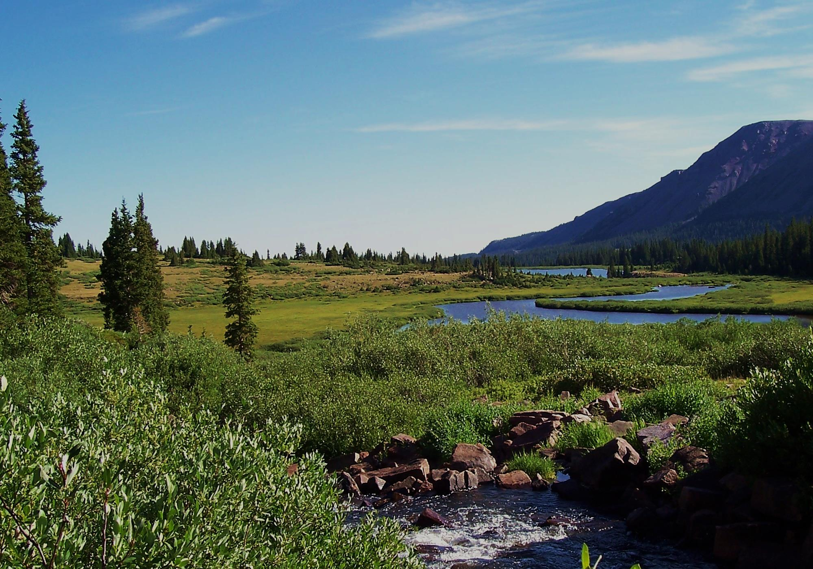
Intro to Public Land Survey
Notes:
-Used to describe place of use
-Utah has two grid systems:
Salt Lake Basin Meridian: starts at temple square
Uintah Special Meridian: Around Duchesne county

Slide 16
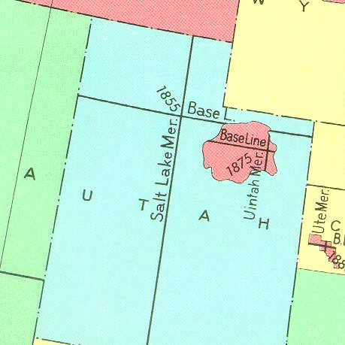
Utah Base & Meridians
Salt Lake B&M
  Beginning in Downtown Salt Lake
Uintah B&M
  Beginning about nine miles North of Roosevelt
Notes:
Salt Lake Basin covers most of the state, so this is the default system we use. Begins as temple square
Uintah Special is located roughly 9 miles North of Roosevelt

Slide 17
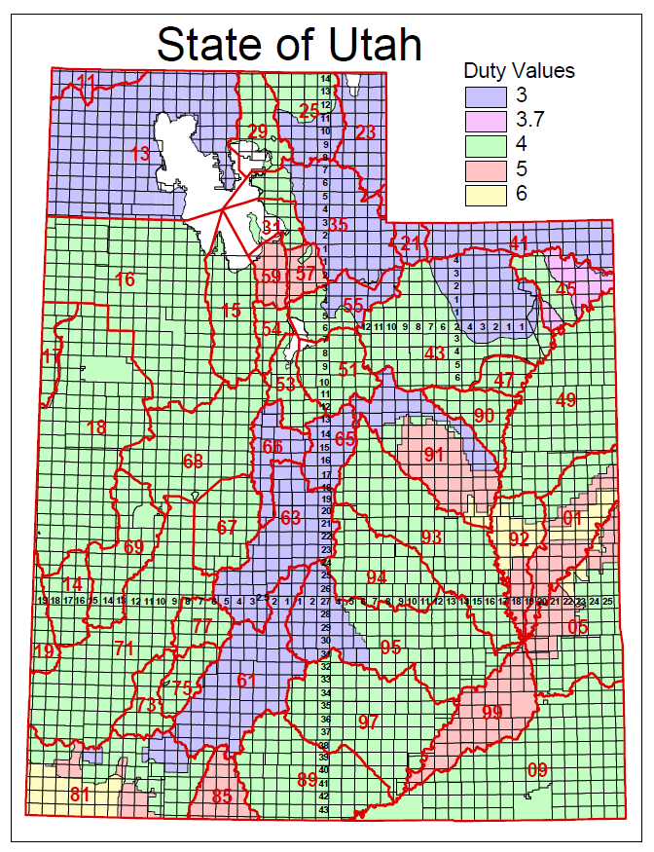
Roosevelt,
Duchesne County
  Township 4 South, Range 5 West, USB&M
Stockton,
Tooele County
  Township 4 South, Range 5 West, SLB&M
Notes:
What problems this can cause:
Increase time to a decision by a month or more, if advertised incorrectly
Could require a change application to be filed to correct the description (Another filing fee for a change app and more time)

Slide 18
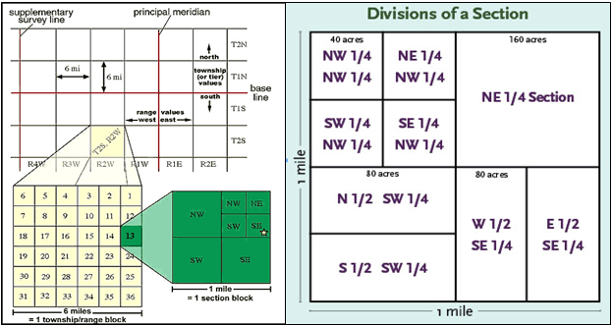
Township, Range, and Section
  Township—Typically a six-mile square area of land containing 36 sections.
  May also refer to a North-South column in the PLSS grid
  Range—An East-West row in the PLSS grid
  Section—Typically a one-mile square area, containing 640 acres.
Notes:
Township: 6 mile square area that goes north and south. Each can be broken into 36 sections.
Range: East and West rows in PLSS grid.
Each of the 36 sections are 1 mile each = 640 acres.
¼ ¼ = 40 acre tract
Rivers, lakes, mountains, state borders are a few things that can cause irregular townships and sections which cause lots

Slide 19
Typical Corner Sections and Quadrants
NW
N
NE
W
E
SW
S
SE
Notes:
Each section has sections corners:
NE Corner
N Quarter Corner (even though it is not a true corner)
NW Corner
ETC

Slide 20
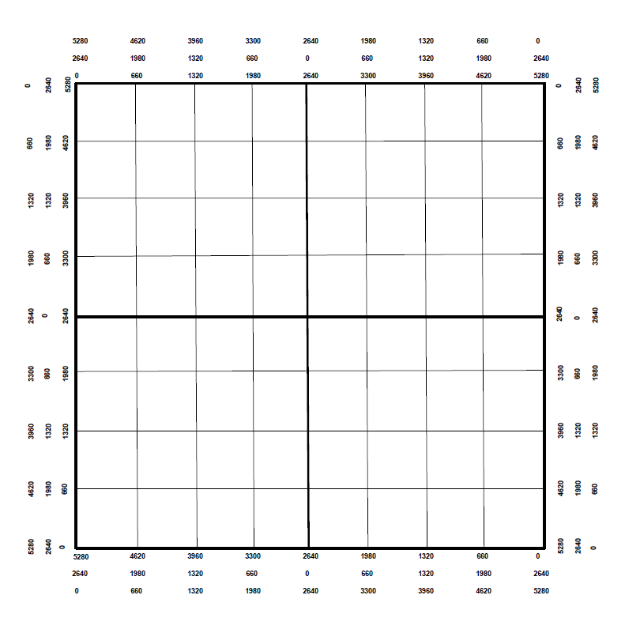
Marking a Point of Diversion
N
Locate the following:
  S 500’ and W 1200’ from the East Quarter Corner
  N 2000’ from the Southeast Corner
  S 1300’ and E 4000’ from the Northwest Corner
NW
W
E
E
SE
S

Slide 21
Marking a Place of Use
N
Locate the following:
  NW1/4 of the NW1/4
  S1/2 of the SW1/4
  NE1/4 of the SW1/4
  S1/2 of the NW1/4 and the S1/2 of the NE1/4
W
E
S

Slide 22
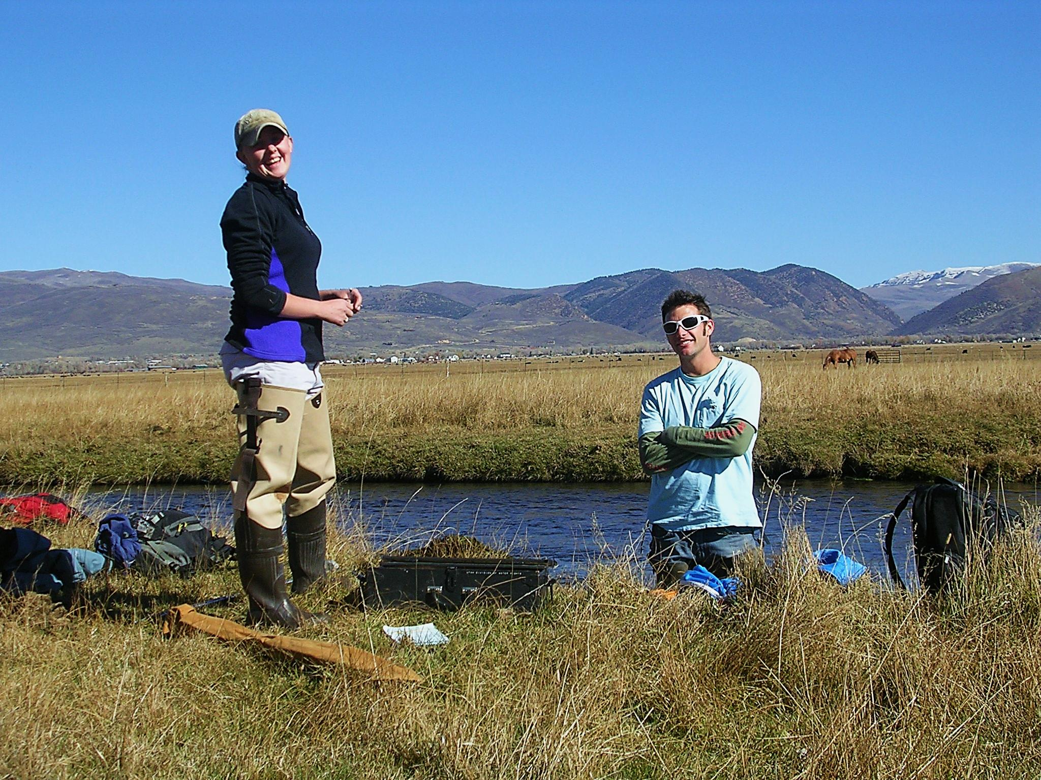
Water Right Calculations

Slide 23
Common Terms
Cubic Feet per Second (CFS)
  A unit of measure used to quantify the rate of flow from a water source
  Area(feet²) * Velocity (feet per second)
Acre-Feet (AF)
  A unit of volume defined as one acre of surface area to a depth of one foot.
  Depth of Water (feet) * Area (acres)
Notes:
CFS = Rate of Flow
AF = Volume, 1 acre of land with water a foot deep

Slide 24
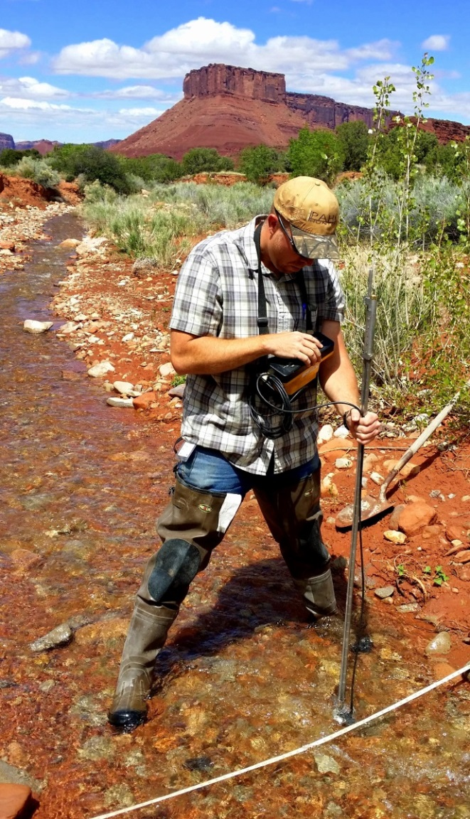
Duty Calculations
Irrigation
  Acres * Duty = AF per Year
  Irrigation duty values vary by area
Domestic
  Full time = 0.45 AF per Year
  Part time = 0.25 AF per Year
Livestock (ELU)
  1 ELU = 0.028 AF per year
  1 ELU = 1 Cow or Horse
  1 ELU = 5 Pigs, Sheep, or Goats
Notes:
Irrigation:
Duty values vary by area, find them on map. The adjudication process and Decrees determine duty per area.
Per year actually means per irrigation season.
Livestock:
ELU: Equivalent Live Stock Unit
Chickens = 33.3

Slide 25
Sample Problem #1
A rancher wants to start a farm near Dugway, Utah (area 16). How much water does he need for 5 acres of irrigation, 50 cattle year-round, and a full-time home?
The irrigation duty in Dugway is 4 acre-feet/acre
  5 acres * 4 acre-feet/acre = 20 acre-feet
  50 cattle * 0.028 acre-foot = 1.4 acre-feet
  1 full-time home = 0.45 acre-foot
  Total diversion = 21.85 acre-feet
+

Slide 26
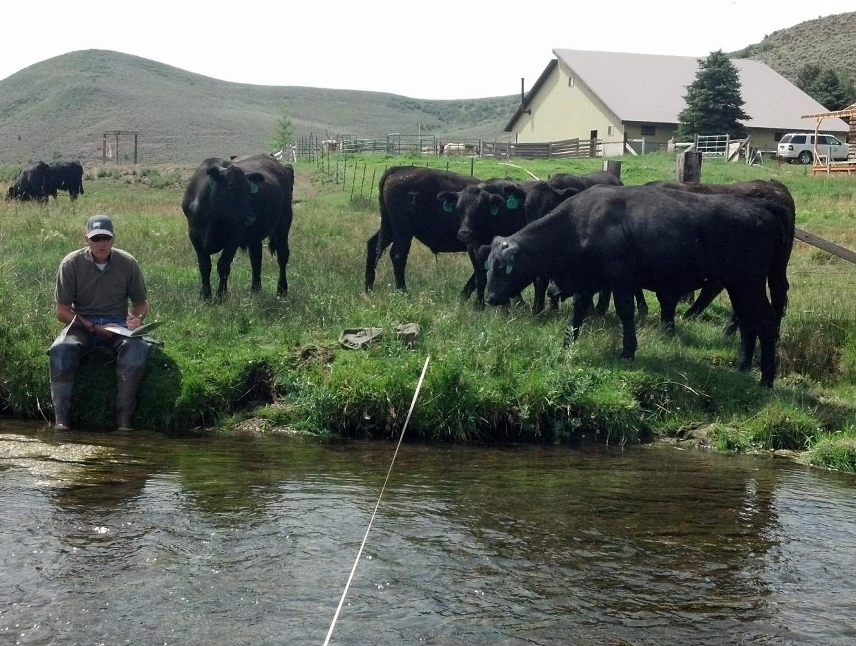
Sample Problem #2
A rancher has a water right for 300 cattle. How many sheep could he provide for with this water right?
300 cattle * 5 = 1500 sheep

Slide 27
Sample Problem #3
A developer wants to build a 10 lot subdivision in Delta, Utah (area 68). Each lot is supposed to have enough water for 0.25 acre of irrigation, 2 horses, and a full-time home. How much diversion will the water right need to have?
  Each lot requires
    0.25 acre * 4 acre-feet/acre = 1.0 acre-foot
    2 horses * 0.028 acre-foot = 0.056 acre-foot
    Full-time home = 0.45 acre-foot
    Total of 1.506 acre-feet per lot
  Total project requires
    1.506 acre-feet * 10 lots = 15.06 acre-feet
+
Notes:
Will this rancher need to file a change application with us if he is switching from cattle to sheep? No, livestock is livestock, as long as he is converting correctly.

Slide 28
Sample Problem #4
A farmer has a water right in Brigham City (area 29) that serves 150 cattle year-round. He wants to change the water right to supply one full-time home, one part-time home, 10 horses, and irrigation for his yard. What is the maximum area (in acres) that can be irrigated, after the other uses are accounted for?
    150 cattle * 0.028 acre-foot = 4.2 acre-feet
    Full-time home = 0.45 acre foot
    Part-time home = 0.25 acre foot
    10 horses * 0.028 acre-foot = 0.28 acre foot
    Total of 0.98 acre-foot
    4.2 acre-feet - 0.98 acre-foot = 3.22 acre-feet
    3.22 acre-feet / 4 acre-feet per acre = 0.805 acre
+
Notes:
Sample of Diversion and Depletion
Water right is for 2.0 acres of irrigation (duty 4) = 8.0 AF
Change to livestock
8.0 with a depletion of 50% = 4.0 AF of depletion
Livestock is 100% depletive so the allowable diversion for a change app would be 4.0AF
Historic use of irrigation would have been 8.0 AF of diversion and 4.0 AF of depletion
142.86 ELU (proposed change) would allow 4.0 AF of diversion and 4.0 AF of depletion
Without diversion adjustment the historic depletion would have been exceeded, enlarging the water right.

Slide 29
Diversion vs Depletion
Diversion is the water removed from the source to be used.
  E.g. Diverting 4.0 AF of water to irrigate 1.0 acre of land
Depletion is the amount of water that is consumed after application.
  E.g. After diverting 4.0 AF of water to irrigate 1.0 acre only 2.0 AF of water returns to the natural water system.
When evaluating Change Applications the State Engineer looks at the historical values for both diversion and depletion.
  Neither value can be enlarged.
Notes:
Depletion is the amount that is not consumed by crop, evaporation, livestock etc and returns to the natural source.
In applications to appropriate we don’t worry about depletion because there is no historic use for the water. Change applications is where this applies. This is where haircuts come in because the historic diversion and depletion cannot be enlarged.

Slide 30
Sample Problem #5
A water right owner has a water right for 3.0 acres of irrigation (duty is 4 feet per acre). He wants to change the use to include 50 cattle. How many acre-feet of water will he be able to divert after the change? Assume the rate of depletion for irrigation is 53%.
  Establish historic diversion and depletion
  3.0 acres * duty of 4 = 12.0 acre-feet (diversion)
  12.0 acre-feet * 53% = 6.36 acre-feet (depletion)
  Figure proposed uses
  50 cattle * 0.028 acre-foot = 1.4 acre-feet (100% consumptive)
  6.36 acre-feet – 1.4 acre-feet = 4.96 acre-feet depletion left
  4.96 acre-feet / 53% = 9.36 acre-feet remaining diversion
  9.36 acre-feet / duty of 4 = 2.34 acres of irrigation
  1.4 acre-feet + 9.36 acre-feet = 10.76 acre-feet of diversion
Notes:
*The rates of depletion are based on a study from Utah State (Consumptive Use of Irrigation Crops) utilizing stations around Utah measuring consumption in alfalfa.
Using Kamas Station for annual irrigation of alfalfa 19.29 inches or 1.6 feet, based on Dr. Hill’s Crop Consumption research.

Slide 31
Summary of Diversion and
Depletion Limits
Historical Use | Diversion | Rate of Depletion | Amount of Depletion
Irrigation: 3.0 acres | 12.0 acre-feet | 53% | 6.36 acre-feet
Totals | 12.0 acre-feet |  | 6.36 acre-feet
Proposed Use | Diversion | Rate of Depletion | Amount of Depletion
Irrigation: 2.34 acres | 9.36 acre-feet | 53% | 4.96 acre-feet
Livestock: 50 ELU | 1.4 acre-feet | 100% | 1.4 acre-feet
Totals | 10.76 acre-feet |  | 6.36 acre-feet
Notes:
Without considering depletion the diversion would have looked like: 10.6 acre-feet for irrigation (2.65 acre)

Slide 32
Diversion Based Change Applications
Why it feels like a “haircut”
  In this scenario depletion is exceeded by 0.66 acre-foot
Historical Use | Diversion | Rate of Depletion | Amount of Depletion
Irrigation: 3.0 acres | 12.0 acre-feet | 53% | 6.36 acre-feet
Totals | 12.0 acre-feet |  | 6.36 acre-feet
Proposed Use | Diversion | Rate of Depletion | Amount of Depletion
Irrigation: 2.65 acres | 10.6 acre-feet | 53% | 5.62 acre-feet
Livestock: 50 ELU | 1.4 acre-feet | 100% | 1.4 acre-feet
Totals | 12.0 acre-feet |  | 7.02 acre-feet
Notes:
Without considering depletion the diversion would have looked like: 10.6 acre-feet for irrigation (2.65 acre)
If we had not taking depletion into account then the depletion amount under the change would exceed the original 6.36
The State Engineer’s office evaluates diversion and depletion on all change applications. Most applications come in based on diversion only. When the final order is issued the applicant may feel like water was taken away from him because it was not expected nor understood.

Slide 33
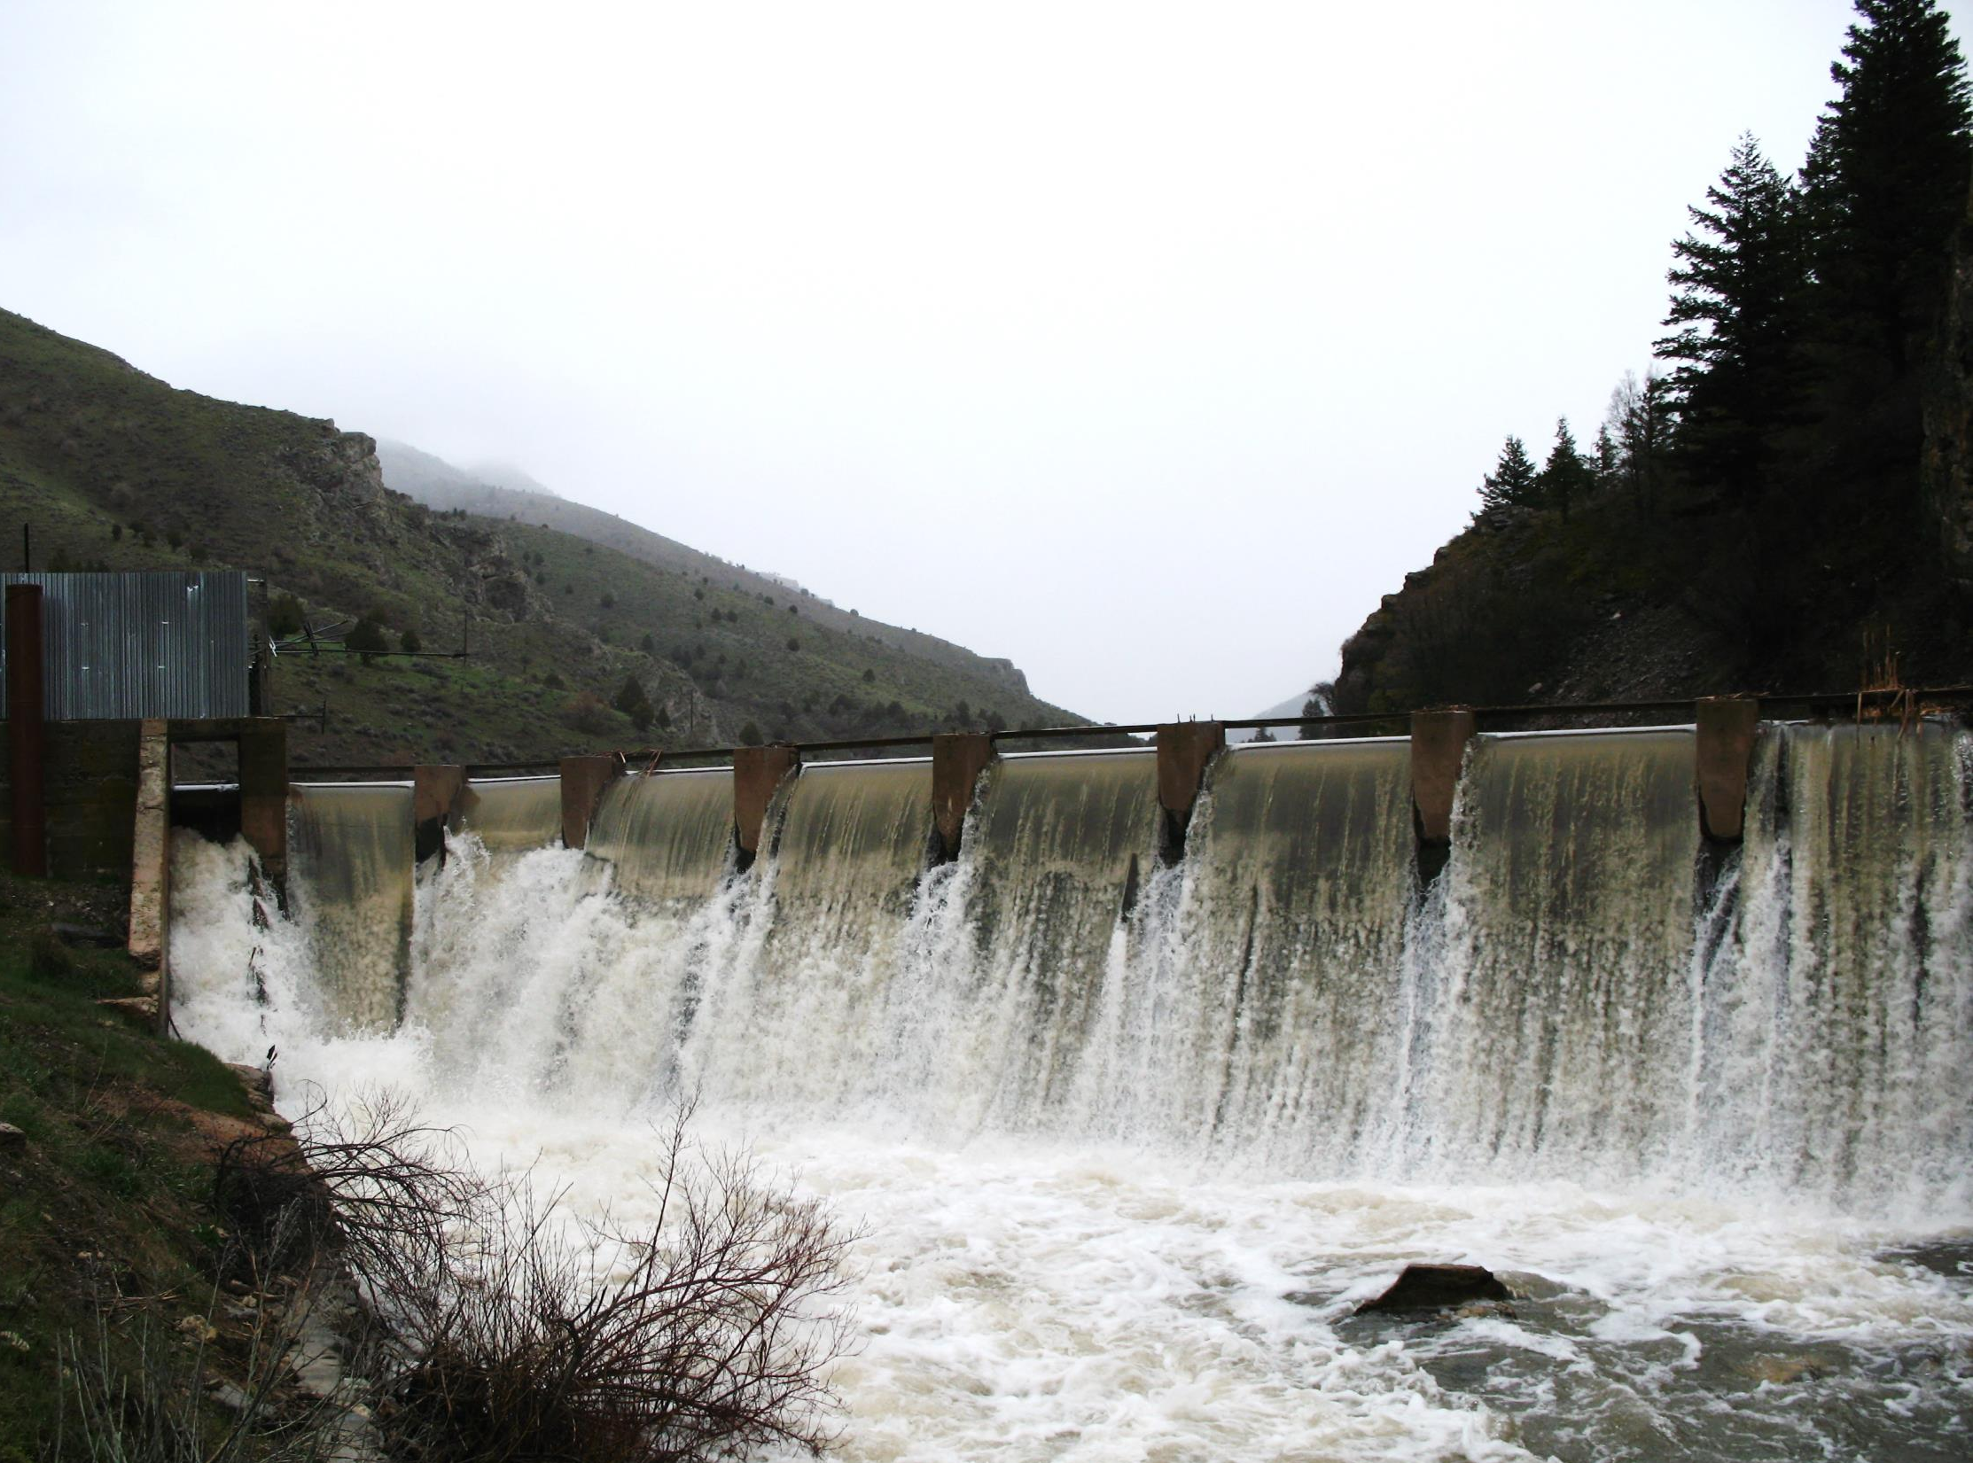
Making an Application Map

Slide 34
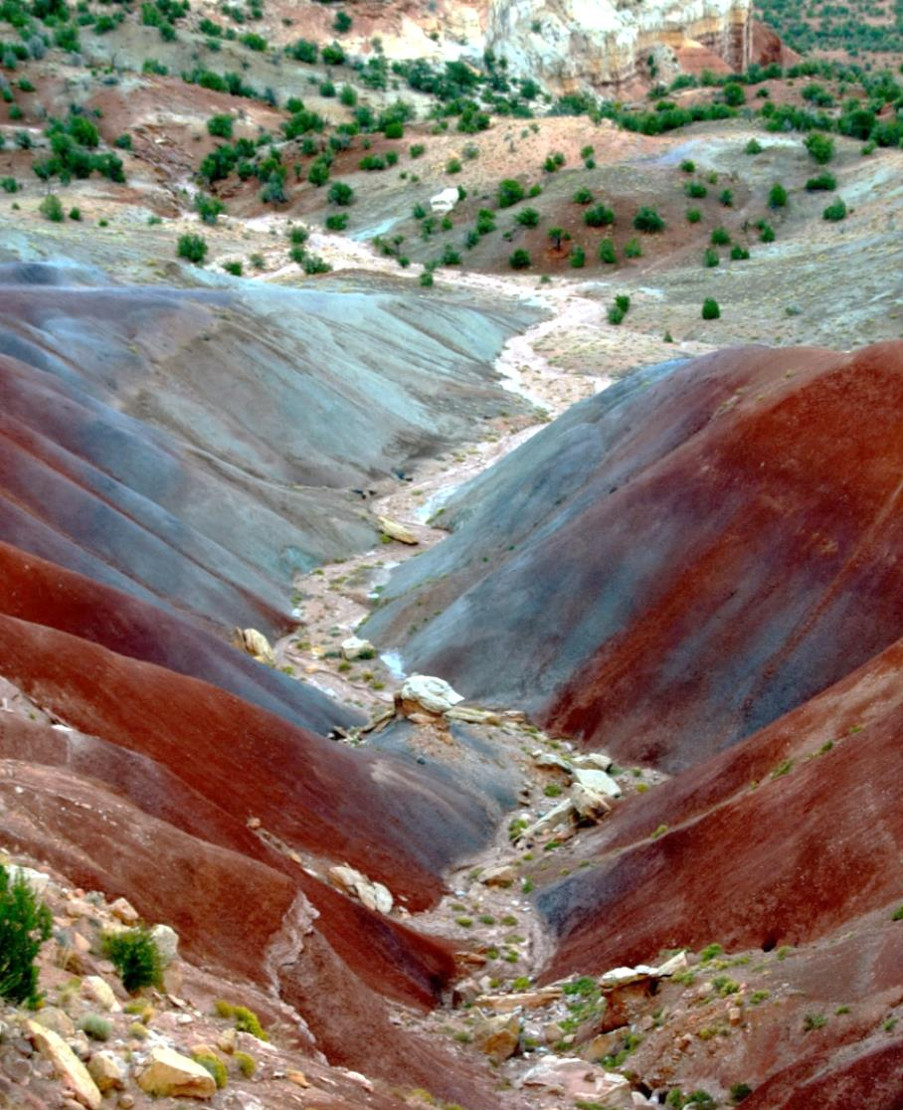
Using the Division’s Website to Get a Point of Diversion (POD)
Be able to locate the property from an aerial map.
Know the approximate location where the well or point of diversion will be located
Notes:
Find Map Wizard on our website to propose the approx. POD and POU

Slide 35
Application Map Wizard
Access from the application/form link on the Division’s Website.
Allows a user to select a point of diversion and place of use from an aerial photo and print a map to accompany an application.
Can be generated with signature lines.
Not acceptable as a proof map.
Notes:
Can be generated with signature lines, or can be turned off. If your map comes in separate from your app, signatures from all owners are needed.

Slide 36
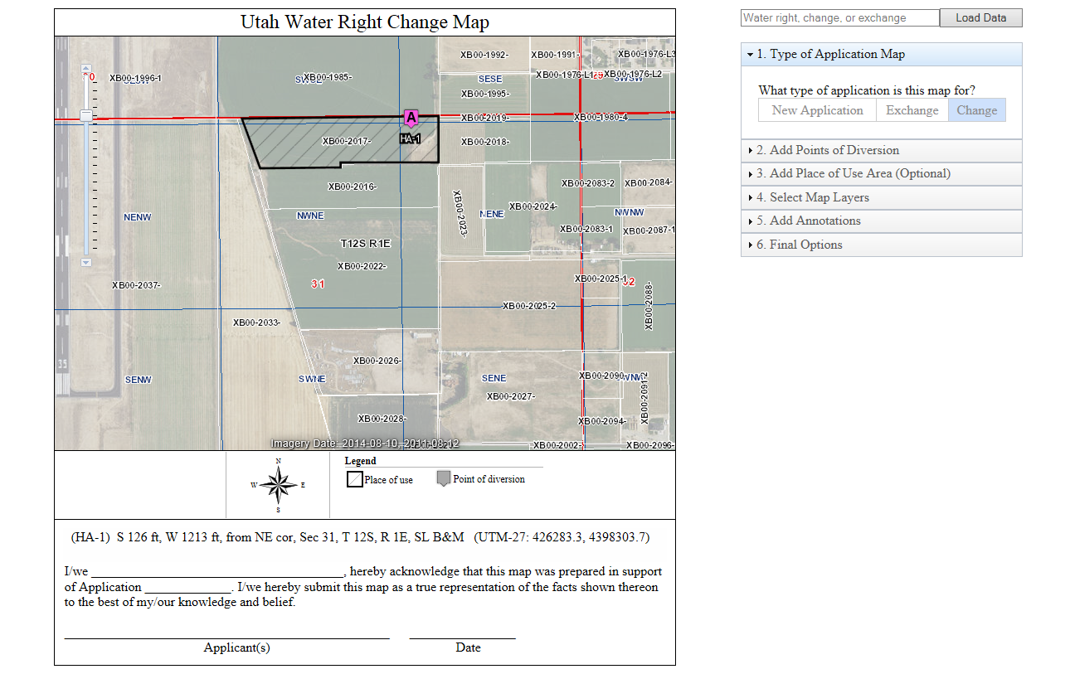
Sample Application Map
Notes:
Point out signature block
Place of use is NW of the NE and NE of the NE of section 31. Hatched area is the parcel line where you will be using the water.
Pink is POD, which will list below, which should match application.

Slide 37
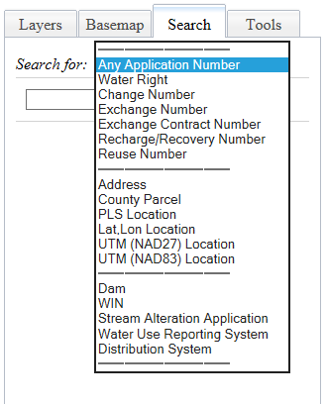
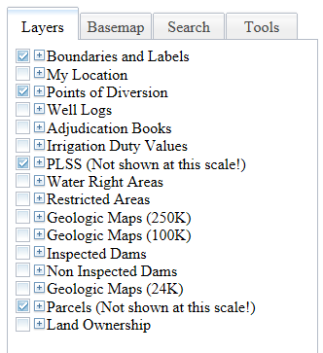
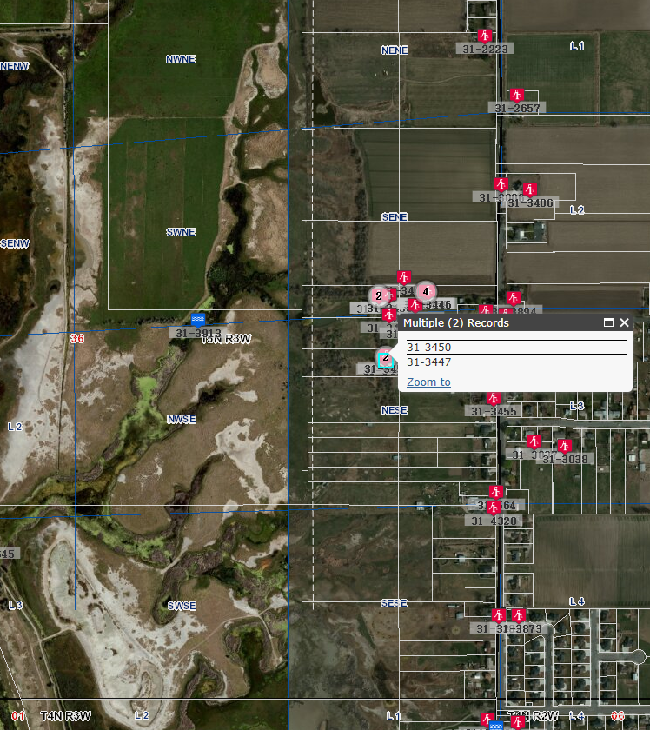
Layers and Search Tools
Notes:
Red icon: Wells
Blue: Surface such as stream/river
#: Multiple water rights associated, click to create hyperlink
White lines are parcel lines. Checked Layers are active
Basemap: Change to topo, historical, roads
Search: WR #, App #, Address, Parcel
Note: Parcel may or may not need dashes, try both. May need to include four 0s after parcel
Tools: Print map, annotate, measure distance or area

Slide 38
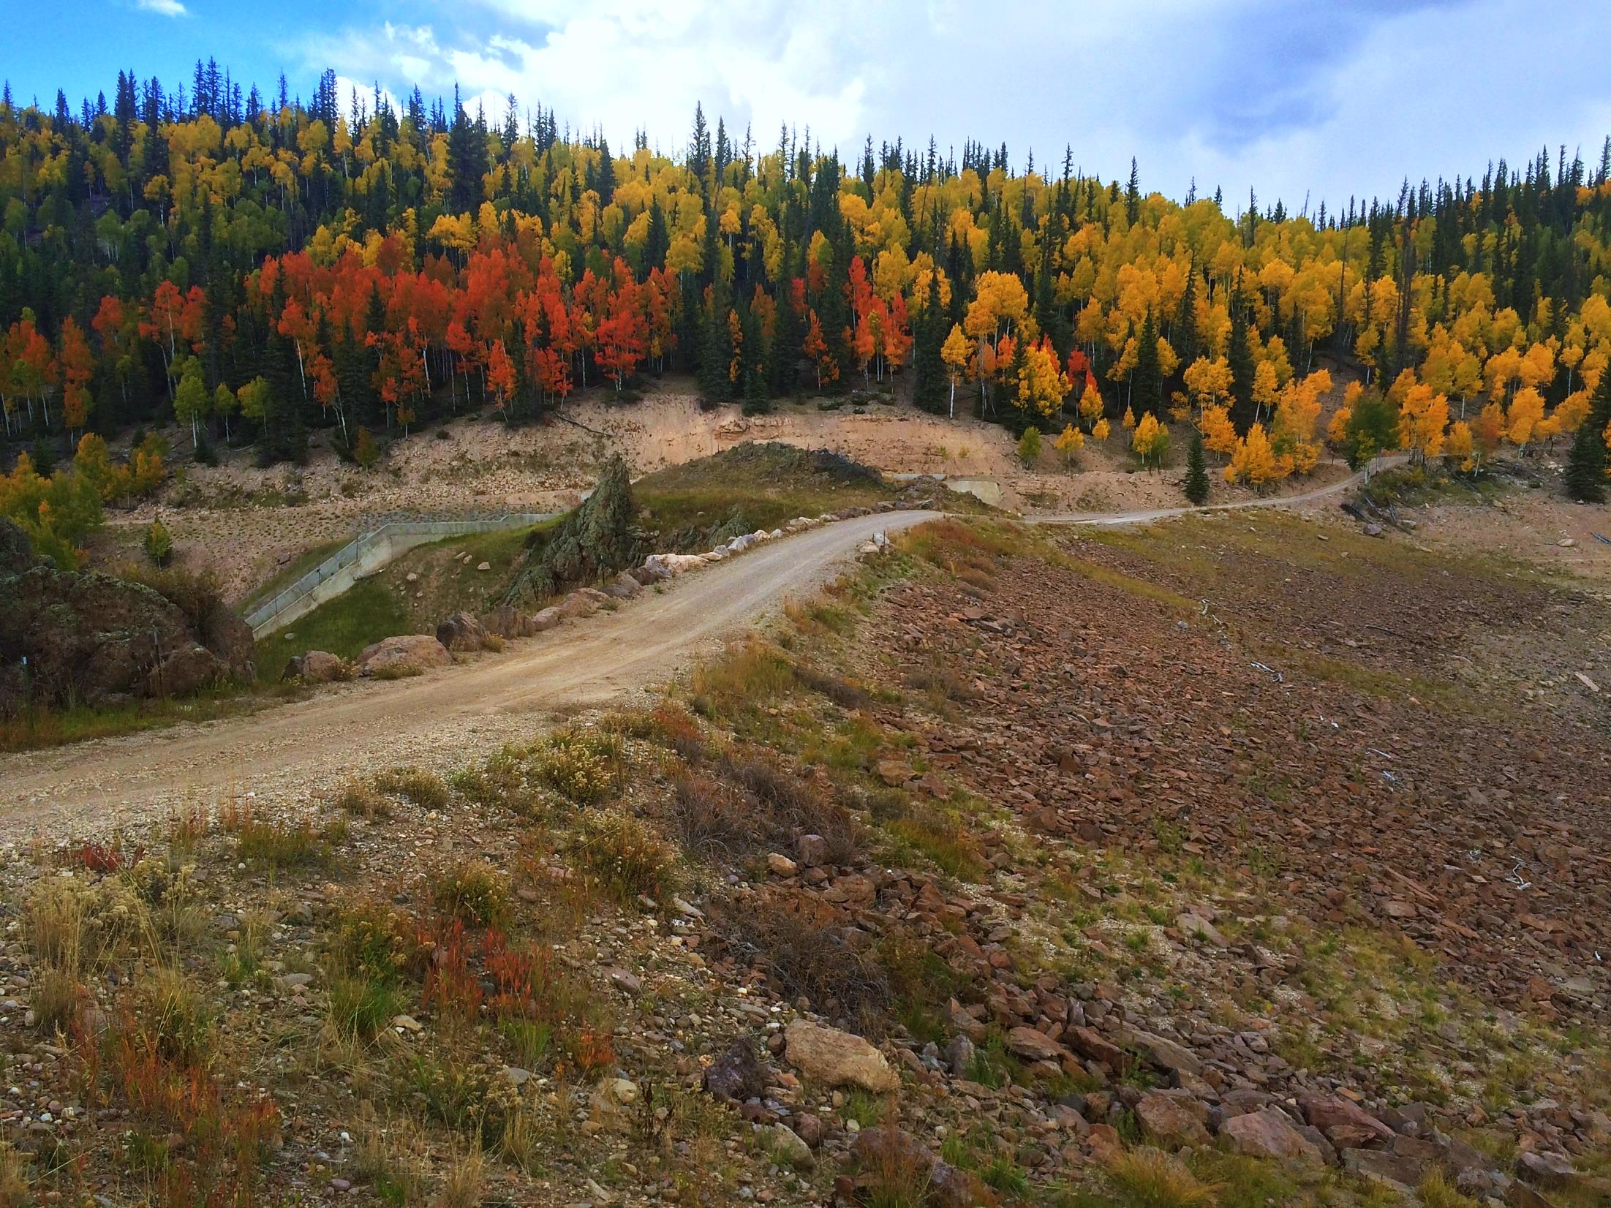
Summary and Wrap-Up

Slide 39
Topics Covered
Elements common to all applications
Intro to the Public Land Survey System
Basic water right calculations
How to use the Division’s website to create an Application Map

Slide 40
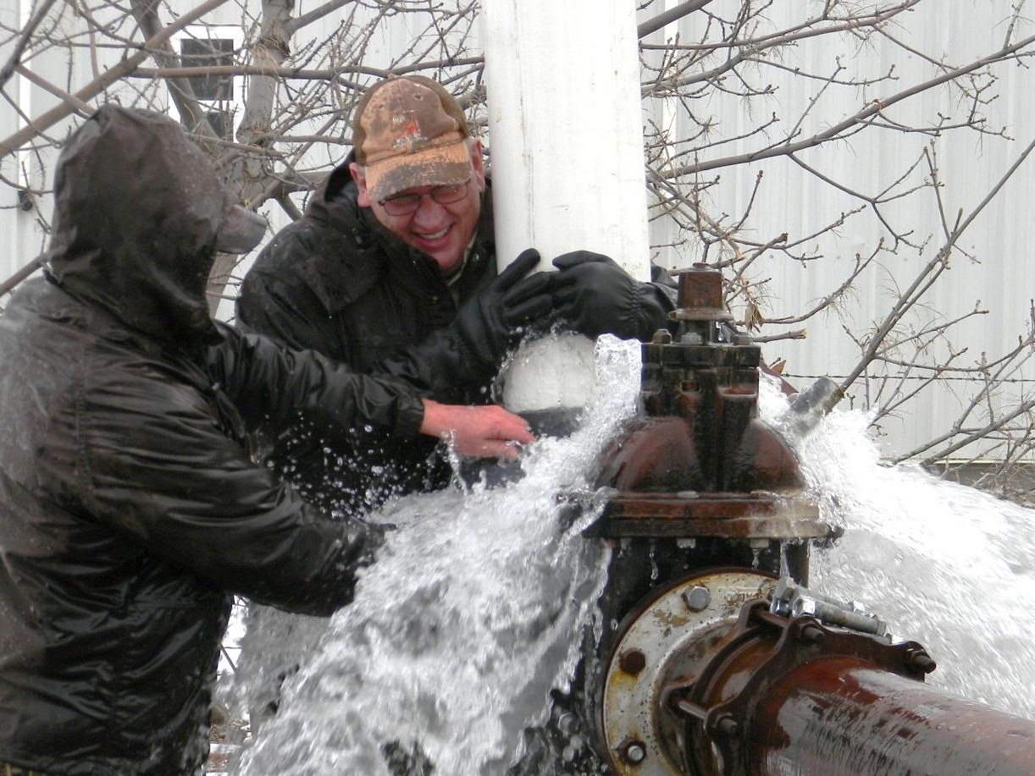
Questions?

